Slide 1
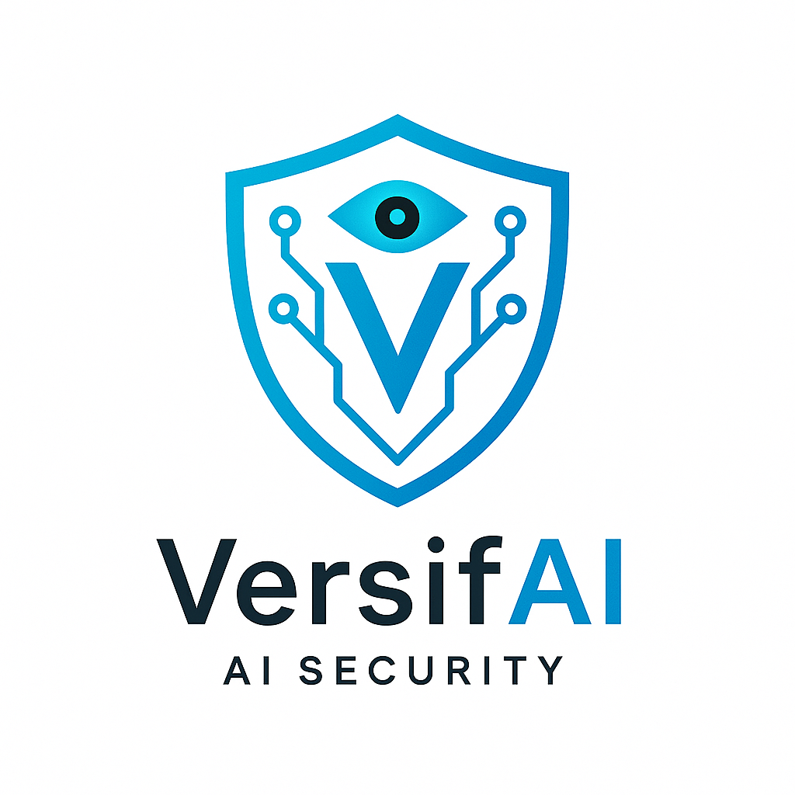

Introduction of AI Agents
Presented by: Sourour Hammoud
August 2,2025

Slide 2

Plan:
What are LLMs?
What are AI Agents?
Components of AI Agents
Cycles of AI Agents
Types of Agents
When to use AI Agents
AI Agent Frameworks
Tool Use Design Pattern
Agentic Design Principles
Guardrails

Slide 3


What are llmS?

Slide 4
An LLM is a type of AI model that excels at understanding and generating human language It learns by reading huge amounts of text, so it can understand how language works. Most modern LLMs use something called a Transformer. [1]
TYPES OF TRANSFORMER
ENCODER
DECODER
SEQ2SEQ

Slide 5
TYPES OF ENCODER:
BERT
RoBERTa
Many popular encoder-based Transformer models such as RoBERTa, DistilBERT, and ALBERT are variants or improvements of the original BERT architecture, sharing its core design while optimizing for performance, size, or training efficiency. [3]

Slide 6
TYPES OF DECODER:
GEEDY DECODING
BEAM SEARCH

Slide 7
What are AI AGENTS?

Slide 8
AI Agents are systems that enable Large Language Models(LLMs) to perform actions by extending their capabilities by giving LLMs access to tools and knowledge.[3]
The concept of agents existed before the creation of LLMs (Large Language Models). The advantage of building AI Agents with LLMs is their ability to interpret human language and data.[3]

Slide 9
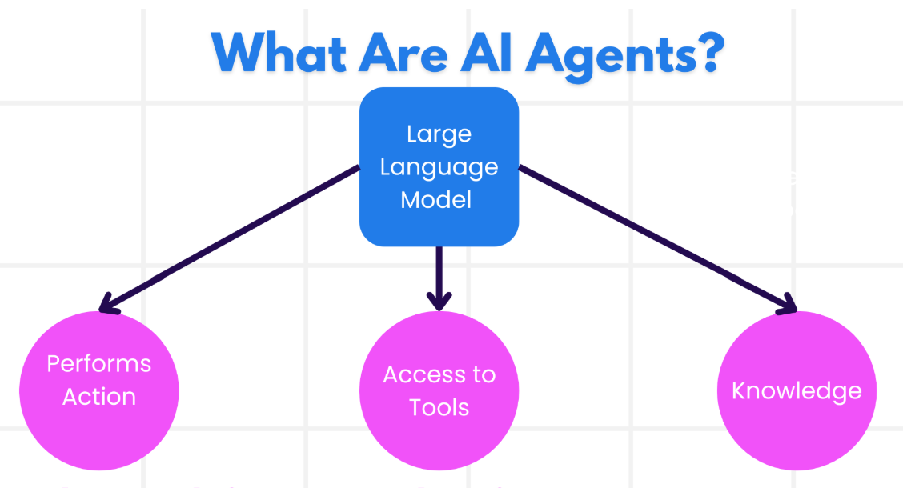
[3]

Slide 10
Components of ai agents

Slide 11


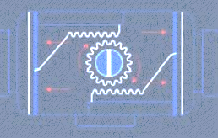
ENVIRONMENT
SENSORS
ACTUATORS

Slide 12
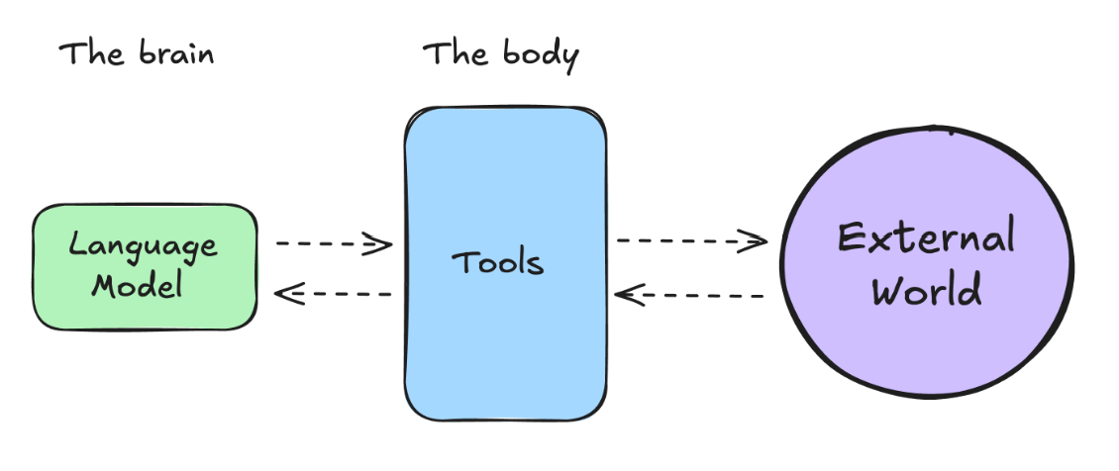
[6]

Slide 13
CYCLES OF AI AGENTS

Slide 14
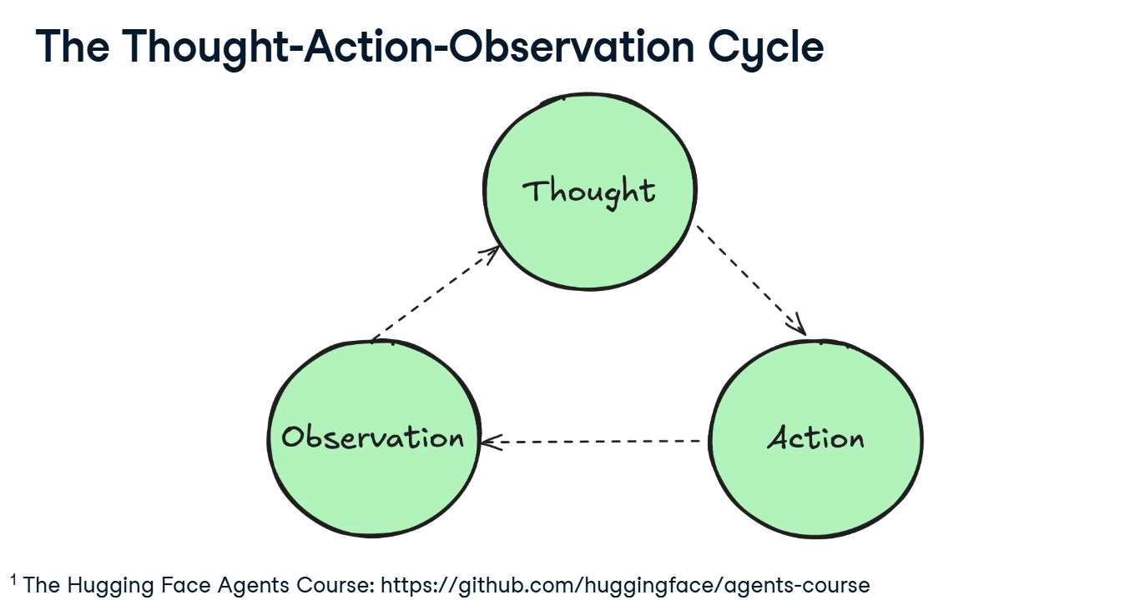
[6]

Slide 15
TYPES OF THOUGHT:
Planning
Decision Making
Problem Solving
Memory Integration
Analysis
Self Reflection
Goal Setting
Prioritization

Slide 16
TYPES OF AGENT ACTION FORMAT:
JSON File
Code Agent
Function Calling Agent
TYPES OF ACTION:
Information Gathering
Tool Usage
Environment Interaction
Communication

Slide 17
TYPES OF OBSERVATION:
System Feedback
Data Changes
Environment Data
Response Analysis
Time-based Events

Slide 18
TYPES OF AGENTS

Slide 19







SIMPLE REFLEX AGENTS
MODEL BASED REFLEX AGENTS
GOAL BASED AGENTS
UTILITY BASED AGENTS
LEARNING AGENTS
HIERARCHICAL AGENTS
MULTI AGENTS SYSTEMS(MAS)

Slide 20
LEVEL OF AGENCY:
Simple Processor: A model that generates outputs directly from inputs without planning or external interactions [4]
Router: A model that selects or routes to the most relevant operation or instruction path depending on context. [4]
Tool Caller: A model that learns to invoke external tools to enhance its performance on tasks. [4]
Multi Step Agent: An agent that reasons across multiple steps by combining intermediate outputs before arriving at a final answer. [4]
Multi Agent: An architecture where several specialized models or agents interact to solve tasks collaboratively or competitively. [4]

Slide 21
Cisco AI Agent
Webex AI Agent: A conversational AI assistant that delivers fully automated, human‑like interactions across voice and digital channels. It autonomously handles high‑volume customer inquiries, resolves issues, and smoothly escalates to human agents when needed.[5]
Cisco AI Assistant for Webex Contact Center: Aimed at supporting live agents, it offers real-time features like suggested responses, transcription, call summaries, and agent Wellness analytics to boost productivity and customer satisfaction. [5]

Slide 22
WhEN TO USE AI AGENTS

Slide 23
Open Ended Problems
Multi Step Processes
Improvement Over Time
Multiple actions
Tool usage
Adapts behavior
Task is not clear
Learn from feedback
dynamic
hardcoded
Multi turn reasoning
Repetitive

Slide 24
AI AGENT FRAMEWORKS

Slide 25
Traditional AI Frameworks can help you integrate AI into your apps and make these apps better in the following ways:
-Personalization: AI can analyze user behavior and preferences to provide personalized recommendations, content, and experiences.[3]
-Automation and Efficiency: AI can automate repetitive tasks, streamline workflows, and improve operational efficiency.[3]
- Enhanced User Experience: AI can improve the overall user experience by providing intelligent features such as voice recognition, natural language processing, and predictive text.[3]

Slide 26
Use Modular Components: AI Agent frameworks like Microsoft Semantic Kernel and Lang Chain give you ready-made parts like AI connectors, memory tools, and prompt templates. These help teams build smart systems quickly without starting from zero. [3]
Leverage Collaborative Tools: Leverage collaboration tools means using AI tools to create agents that work together. Each agent does a different job, like finding data or making decisions. Together, they solve tasks faster and better.[3]
Learn in Real-Time: AI agents can learn while working. They look at what happens, learn from mistakes, and do better next time. This helps them improve over time.[3]

Slide 27
The differences between AutoGen, Semantic Kernel and Azure AI Agent Service are:
Framework | Focus | Core Concepts | Use Cases | TYPE
AutoGen | Event-driven, distributed agentic applications | Agents, Personas, Functions, Data | Code generation, data analysis tasks | Multi-agent collaboration framework
Semantic Kernel | Understanding and generating human-like text content | Agents, Modular Components, Collaboration | Natural language understanding, content generation | developer SDK
Azure AI Agent Service | Flexible models, enterprise security, Code generation, Tool calling | Modularity, Collaboration, Process Orchestration | Secure, scalable, and flexible AI agent deployment | Cloud-based AI agent management

Slide 28
TOOL USE DESIGN PATTERN

Slide 29
The Tool Use Design Pattern focuses on giving LLMs the ability to interact with external tools to achieve specific goals. Tools are code that can be executed by an agent to perform actions. [3]
CASES TO USE THESE TOOLS
Code Execution and Interpretation
Workflow Automation
Dynamic Information Retrieval
Content Generation and Editing
Customer Support

Slide 30
Key Elements of the Tool Use Design Pattern:
Function/Tool Schemas: describe each tools, its name, what it does, input needs and what it returns.[3]
Function Execution Logic: Decides when and how to use tools based on the user’s message and the context of the conversation.[3]
Message Handling System: Manages the flow between the user, the AI, tool requests and tool responses.[3]
Tool Integration Framework: Connect the Agent to actual tools.[3]
Error Handling and Validation: Catches problems like missing or incorrect input, failed tool calls and ensure responses make sense.[3]
State Management: Tracks conversation context, previous tool interactions, and persistent data to ensure consistency across multi-turn interactions.[3]

Slide 31
AGENTIC DESIGN PRINCIPLES

Slide 32



SPACE
TIME
CORE

Slide 33
GUARDRAILS

Slide 34
Tool Guardrails
Input Guardrails
Tools
External World
User
Prompt
Model
Output Guardrails
Response

Slide 35
REFERENCE:
https://huggingface.co/learn/agents-course/en/unit0/introduction [1]
Devlin, J., Chang, M.-W., Lee, K., & Toutanova, K. (2019). In Proceedings of NAACL-HLT 2019. https://arxiv.org/abs/1810.04805 [2]
https://microsoft.github.io/ai-agents-for-beginners/01-intro-to-ai-agents/ [3]
Schick, T., & Schütze, H. (2023). Toolformer: Language Models Can Teach Themselves to Use Tools. arXiv preprint. https://arxiv.org/abs/2302.04761 [4]
Cisco Systems, Inc. (2025, March 17). Cisco Paves the Way with Agentic AI Collaboration. Cisco Newsroom. https://newsroom.cisco.com/c/r/newsroom/en/us/a/y2025/m03/cisco-paves-the-way-with-agentic-ai-collaboration.html [5]
https://app.datacamp.com/learn/courses/introduction-to-ai-agents [6]

Slide 36
Thank You!

